Slide 1

AWS SystemsParameter Store
Centralized Configuration Management for AWS

Slide 2
Introduction
AWS Systems Manager Parameter Store provides secure, scalable storage for configuration data and secrets, enabling centralized management and automation across AWS environments.

Slide 3

01
Overview of AWS Systems Manager Parameter Store

Slide 4

Key Features and Capabilities
Parameter Store supports hierarchical storage of data, secure string parameters with encryption, version tracking, and integrated notifications. It facilitates automation and reduces errors by centralizing configuration management.

Slide 5

Security and Access Management
It offers fine-grained access control with AWS IAM policies and integrates with AWS KMS for encryption, ensuring parameters and secrets remain protected and auditable.

Slide 6
Use Cases and Benefits in Enterprise Environments
AWS Parameter Store is ideal for managing application configurations, secrets, and credentials in a centralized, secure way. It supports compliance requirements, reduces operational complexity, and improves deployment consistency across distributed systems.

Slide 7

02
Managing and Integrating Parameter Store

Slide 8
Parameter Store Architecture and Data Types
Parameter Store supports string, string list, and secure string parameter types. It organizes data hierarchically and supports version control to track changes and rollbacks efficiently.

Slide 9
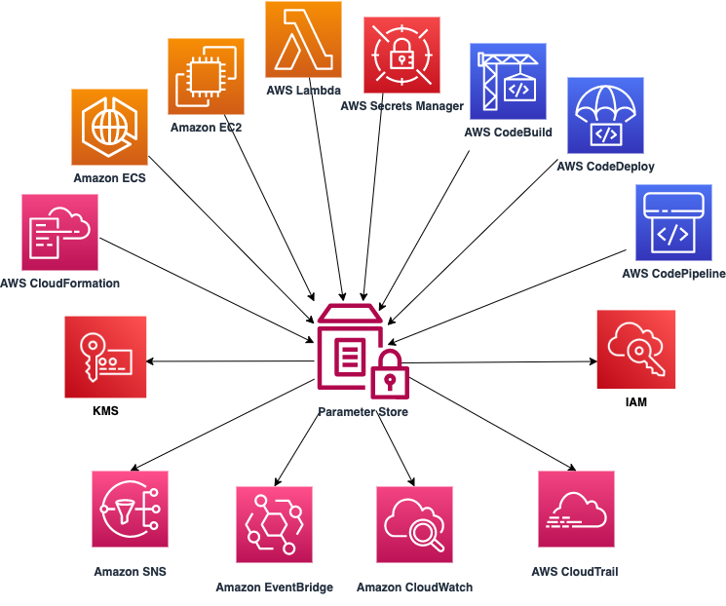
Integration with AWS Services and Automation
Parameter Store integrates seamlessly with AWS Lambda, EC2, CloudFormation, and CodePipeline, enabling dynamic configuration retrieval and automation of deployment workflows.

Slide 10
Best Practices for Parameter Management and Versioning
Use hierarchical naming conventions, enable encryption for sensitive data, implement strict IAM policies, and document changes with version history to ensure secure and maintainable parameter management.

Slide 11
Conclusions
AWS Systems Manager Parameter Store enhances security and operational excellence by centralizing configuration management, enabling automation, and integrating deeply with AWS services for scalable, compliant solutions.

